Slide 1

Emotions and Moods
17th Edition
© 2009 Prentice-Hall Inc. All rights reserved.
8-<number>

Slide 2
Chapter Learning Objectives
After studying this chapter, you should be able to:
  Differentiate emotions from moods, and list the basic emotions and moods.
  Discuss whether emotions are rational and what functions they serve.
  Identify the sources of emotions and moods.
  Show the impact emotional labor has on employees.
  Describe Affective Events Theory and identify its applications.
  Contrast the evidence for and against the existence of emotional intelligence.
  Apply concepts about emotions and moods to specific OB issues.
  Contrast the experience, interpretation, and expression of emotions across cultures.
© 2009 Prentice-Hall Inc. All rights reserved.
8-<number>

Slide 3

Why Were Emotions Ignored in OB?
The “Myth of Rationality”
  Emotions were seen as irrational
  Managers worked to make emotion-free environments
View of Emotionality
  Emotions were believed to be disruptive
  Emotions interfered with productivity
  Only negative emotions were observed
Now we know emotions can’t be separated from the workplace
© 2009 Prentice-Hall Inc. All rights reserved.
8-<number>

Slide 4
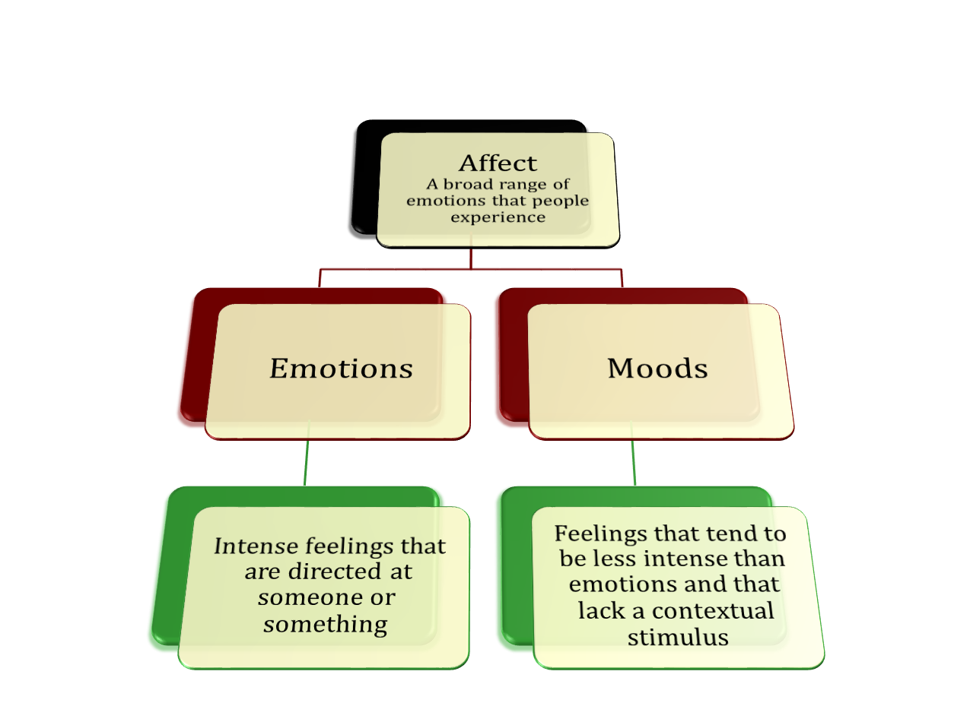
What are Emotions and Moods?
See E X H I B I T 8-1
© 2009 Prentice-Hall Inc. All rights reserved.
8-<number>

Slide 5
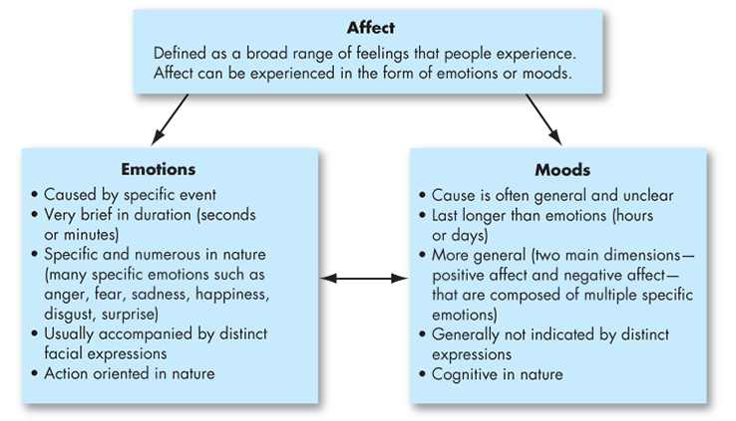
© 2009 Prentice-Hall Inc. All rights reserved.
8-<number>

Slide 6


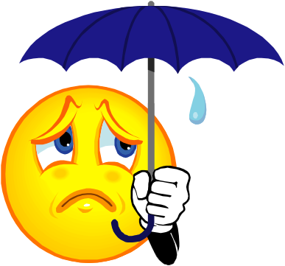



The Basic Emotions
While not universally accepted, there appear to be six basic emotions:
  Anger
  Fear
  Sadness
  Happiness
  Disgust
  Surprise
All other emotions are subsumed under these six
May even be placed in a spectrum of emotion:
  Happiness – surprise – fear – sadness – anger - disgust
© 2009 Prentice-Hall Inc. All rights reserved.
8-<number>

Slide 7
Moral Emotions
Moral Emotions
  Emotion that have moral implications.
  It includes sympathy for the suffering of others, guilt about our own immoral behavior, anger about injustice done to others, and contempt for those who behave unethically.
Moral Disgust
  The disgust we feel about violation of moral norms called moral disgust.
© 2009 Prentice-Hall Inc. All rights reserved.
8-<number>

Slide 8
Basic Moods: Positive and Negative Affect
Positive Emotion
  A mood dimension that consist of specific positive emotions such as excitement, enthusiasm, and elation at the high end.
Negative Emotion
  A mood dimension that consist of emotions such as nervousness, stress, and anxiety at the high end.
Positive offset
  The Tendency of most individuals to experience a mildly positive mood at zero input (when nothing in particular is going on)
© 2009 Prentice-Hall Inc. All rights reserved.
8-<number>

Slide 9
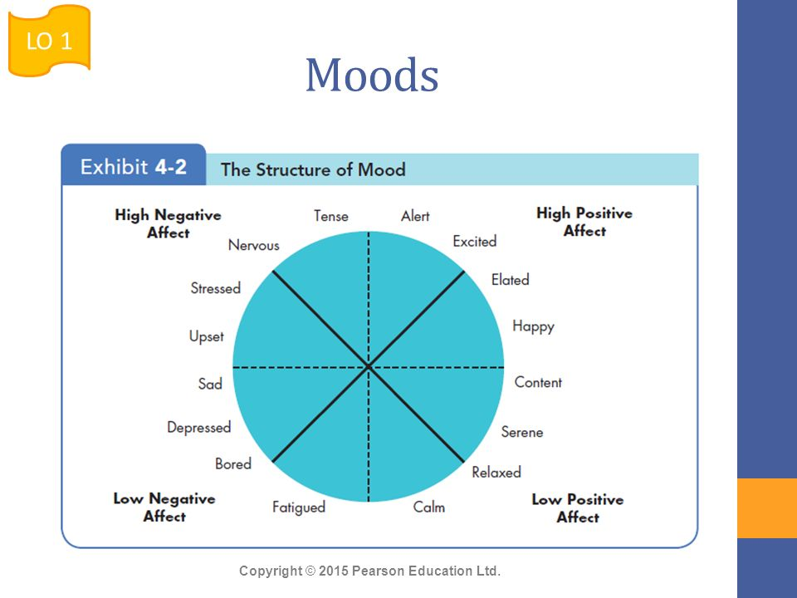
© 2009 Prentice-Hall Inc. All rights reserved.
8-<number>

Slide 10
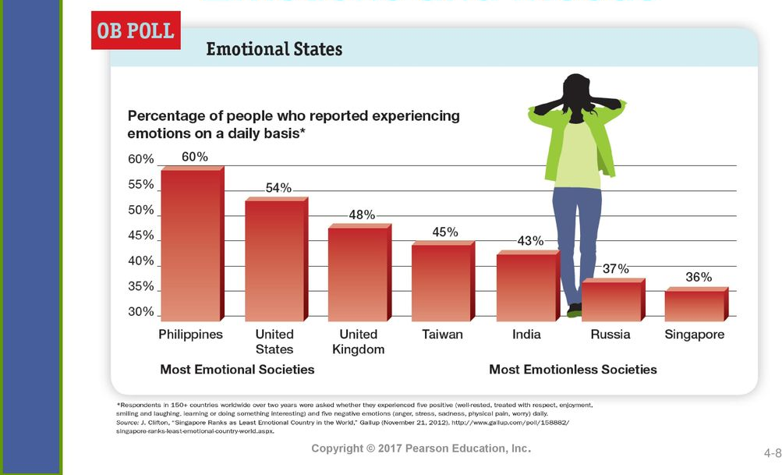
© 2009 Prentice-Hall Inc. All rights reserved.
8-<number>

Slide 11
What Is the Function of Emotion?
In some ways, emotions are a mystery.
Do Emotions Make Us Irrational?
  Expressing emotions publicly may be damaging to social status
  Emotions are critical to rational decision-making
  Emotions help us understand the world around us
  Darwin argued they help in survival problem-solving
  Evolutionary psychology: people must experience emotions as there is a purpose behind them
  Not all researchers agree with this assessment
© 2009 Prentice-Hall Inc. All rights reserved.
8-<number>

Slide 12


Sources of Emotion and Mood
Personality
  There is a trait component – affect intensity
Day and Time of the Week
  There is a common pattern for all of us
    Happier in the midpoint of the daily awake period
    Happier toward the end of the week
Weather
  Illusory correlation – no effect
Stress
  Even low levels of constant stress can worsen moods
Social Activities
  Physical, informal, and dining activities increase positive moods
See E X H I B I T 8-3 and 8-4 for Emotion Timing
© 2009 Prentice-Hall Inc. All rights reserved.
8-<number>

Slide 13
More Sources of Emotion and Mood
Sleep
  Poor sleep quality increases negative affect
Exercise
  Does somewhat improve mood, especially for depressed people
Age
  Older folks experience fewer negative emotions
Gender
  Women tend to be more emotionally expressive, feel emotions more intensely, have longer-lasting moods, and express emotions more frequently than do men
  Due more to socialization than to biology
© 2009 Prentice-Hall Inc. All rights reserved.
8-<number>

Slide 14
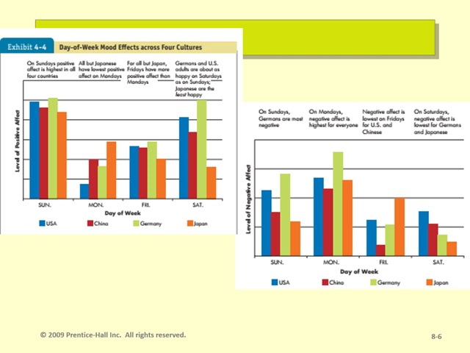

© 2009 Prentice-Hall Inc. All rights reserved.
8-<number>

Slide 15
Emotional Labor
An employee’s expression of organizationally desired emotions during interpersonal transactions at work.
Types of Emotions:
  Felt: the individual’s actual emotions
  Displayed: required or appropriate emotions in a given job.
    Surface Acting: displaying appropriately but not feeling those emotions internally
    Increase stress and decrease job satisfaction.
    Surface acting on daily basis can also lead to emotional exhaustion at home, work family conflict and insomnia
    Deep Acting: changing internal feelings to match display rules -Positive relationship with job satisfaction and job performance.
See E X H I B I T 8-5 for Emotional Labor and Pay
© 2009 Prentice-Hall Inc. All rights reserved.
8-<number>

Slide 16
Emotional Dissonance:
  Employees have to project one emotion while simultaneously feeling another
  Can be very damaging and lead to burnout.
  Long-term emotional dissonance is a predictor for job burnout, declines in job performance and lower job satisfaction.
Mindfulness:
  Objectively and deliberately evaluating the emotional situation in the moment.
© 2009 Prentice-Hall Inc. All rights reserved.
8-<number>

Slide 17
Affective Events Theory (AET)
A model that suggests that workplace event cause emotional reactions on the part of employees, which then influence workplace attitudes and behaviors.
Employees react emotionally.
Such reaction influences their job performance and satisfaction (OCB, OC, level of effort, intention to quit, and workplace deviance)
© 2009 Prentice-Hall Inc. All rights reserved.
8-<number>

Slide 18
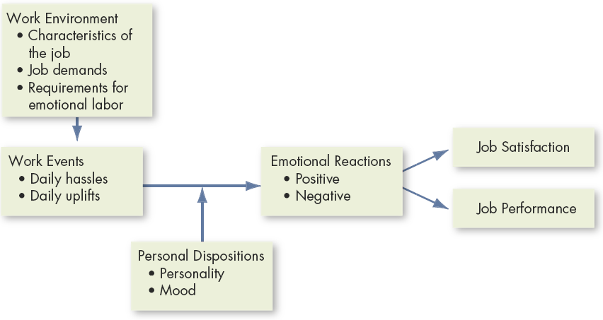
Affective Events Theory (AET)
An event in the work environment triggers positive or negative emotional reactions
  Personality and mood determine response intensity
  Emotions can influence a broad range of work variables
E X H I B I T 8-6
© 2009 Prentice-Hall Inc. All rights reserved.
8-<number>

Slide 19
Implications of AET
An emotional episode is actually the result of a series of emotional experiences triggered by a single event
Current and past emotions affect job satisfaction
Emotional fluctuations over time create variations in job performance
Emotion-driven behaviors are typically brief and variable
Both negative and positive emotions can distract workers and reduce job performance
Emotions provide valuable insights about behavior
Emotions, and the minor events that cause them, should not be ignored at work: they accumulate
© 2009 Prentice-Hall Inc. All rights reserved.
8-<number>

Slide 20
Emotional Intelligence (EI)
A person’s ability to:
  Be self-aware
    Recognizing own emotions when experienced
  Detect emotions in others
  Manage emotional cues and information
EI plays an important role in job performance
EI is controversial and not wholly accepted
© 2009 Prentice-Hall Inc. All rights reserved.
8-<number>

Slide 21
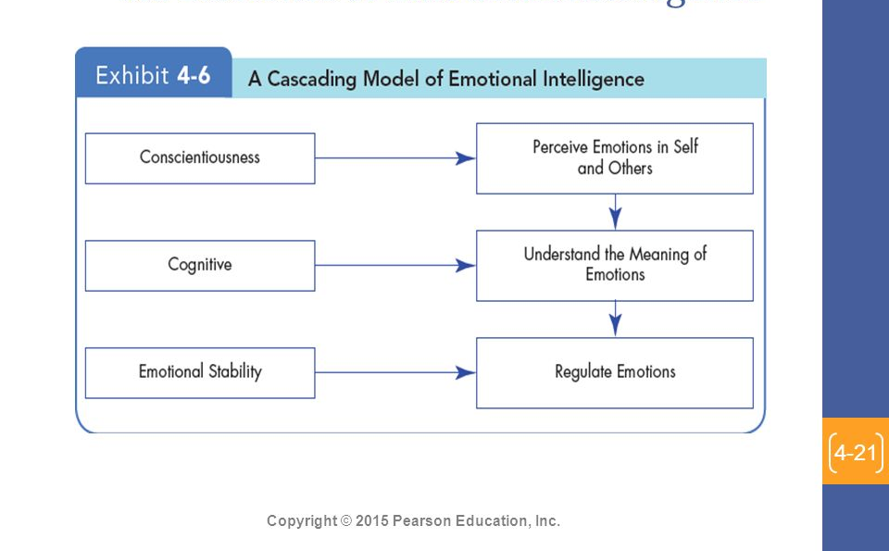
© 2009 Prentice-Hall Inc. All rights reserved.
8-<number>

Slide 22
Emotional Regulation
Emotional regulation influences and outcomes
Emotional Regulation Techniques
Surface Acting
Deep acting
Emotional suppression
Cognitive reappraisal or reframing
Social Sharing or venting
Ethics of emotional regulation
© 2009 Prentice-Hall Inc. All rights reserved.
8-<number>

Slide 23
OB Applications of Emotions and Moods
Selection
  EI should be a hiring factor, especially for social jobs.
Decision Making
  Positive emotions can lead to better decisions.
Creativity
  Positive mood increases flexibility, openness, and creativity.
Motivation
  Positive mood affects expectations of success; feedback amplifies this effect.
Leadership
  Emotions are important to acceptance of messages from organizational leaders.
© 2009 Prentice-Hall Inc. All rights reserved.
8-<number>

Slide 24
More OB Applications of Emotions and Moods
Negotiation
  Emotions, skillfully displayed, can affect negotiations
Customer Services
  Emotions affect service quality delivered to customers which, in turn, affects customer relationships
  Emotional Contagion: “catching” emotions from others
Job Attitudes
  Can carry over to home, but dissipate overnight
Deviant Workplace Behaviors
  Negative emotions lead to employee deviance (actions that violate norms and threaten the organization)
Manager’s Influence
  Leaders who are in a good mood, use humor, and praise employees increase positive moods in the workplace.
© 2009 Prentice-Hall Inc. All rights reserved.
8-<number>

Slide 25

Global Implications
Do people experience emotions equally?
  No. Culture can determine type, frequency, and depth of experienced emotions
Do people interpret emotions the same way?
  Yes. Negative emotions are seen as undesirable and positive emotions are desirable
  However, value of each emotion varies across cultures
Do norms of emotional expression vary?
  Yes. Some cultures have a bias against emotional expression; others demand some display of emotion
  How the emotions are expressed may make interpretation outside of one’s culture difficult
© 2009 Prentice-Hall Inc. All rights reserved.
8-<number>

Slide 26

Summary and Managerial Implications
Moods are more general than emotions and less contextual
Emotions and moods impact all areas of OB
Managers cannot and should not attempt to completely control the emotions of their employees
Managers must not ignore the emotions of their co-workers and employees
Behavior predictions will be less accurate if emotions are not taken into account
© 2009 Prentice-Hall Inc. All rights reserved.
8-<number>

Slide 27

All rights reserved. No part of this publication may be reproduced, stored in a retrieval system, or transmitted, in any form or by any means, electronic, mechanical, photocopying, recording, or otherwise, without the prior written permission of the publisher. Printed in the United States of America.
Copyright ©2009 Pearson Education, Inc. Publishing as Prentice Hall

